Slide 1



Slide 2
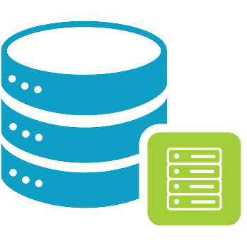
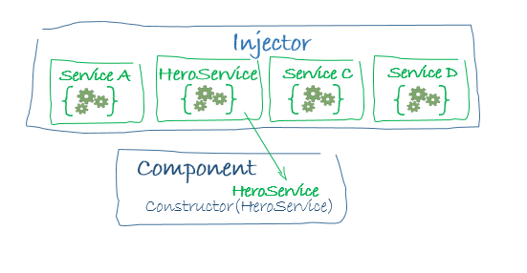
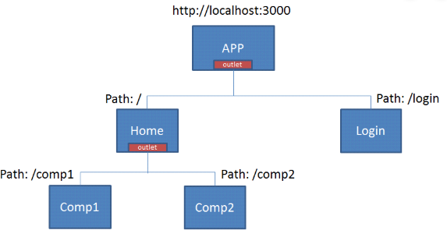
Angular
Models
Services
Router

Slide 3
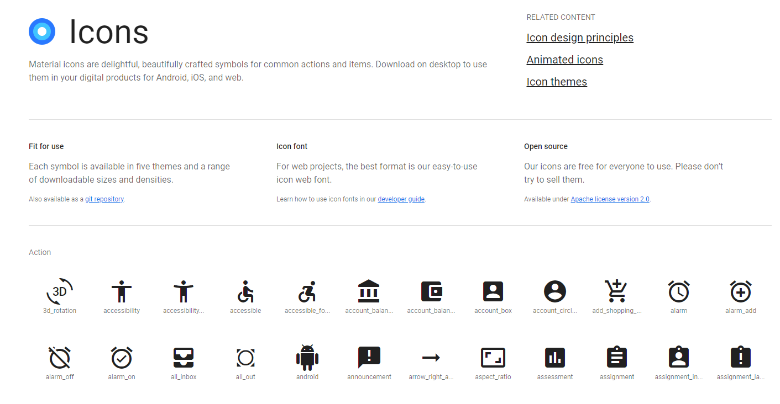
Angular
Registrar los servicios
Head > content > Footer
Environment data
Icon Material

Slide 4
GO!
Coding

